Slide 1
Crowd Sourcing Water Turbidity Information
Nitay ozer
Itay mal
supervisor adi vainiger

Slide 2


Project Goal
Low-cost, portable and highly available solution for crowdsourcing water turbidity information.
Based of personal smartphone, application and DIY measuring kit.

Slide 3
Motivation
water quality
drinking/agriculture water sources
Environmental effects
Public health
Wildlife research
Sediment transport
Water Based Activities
Water sports
Diving

Slide 4
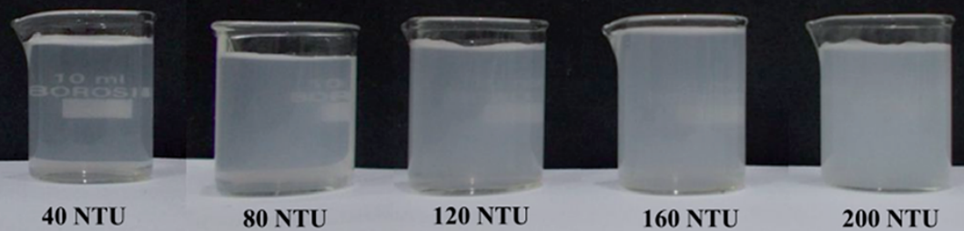
What is turbidity
‘Fogginess’ of a fluid
Commonly measured by NTU or FTU
Image taken from: Hussain, I., Ahamad, K., & Nath, P. (2016). Water turbidity sensing using a smartphone. Rsc Advances, 6(27), 22374-22382.

Slide 5
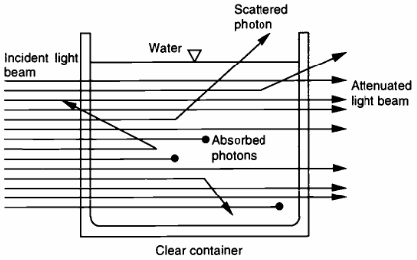
What is turbidity
Intense light scattering caused mainly by fine-particle sediment
Image: Davies-Colley, R.J. and Smith, D.G. (2001), TURBIDITY SUSPENDED SEDIMENT, AND WATER CLARITY: A REVIEW. JAWRA Journal of the American Water Resources Association, 37: 1085-1101.

Slide 6
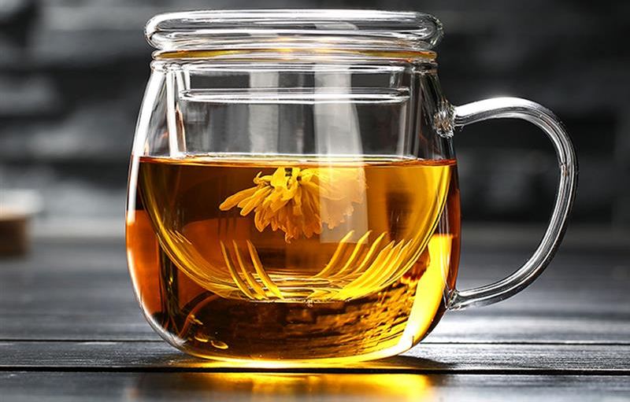
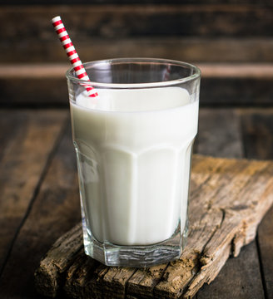
Absorption and Scattering
Tea has high absorption coefficient
Milk has high scattering coefficient

Slide 7
Existing Solutions

Slide 8

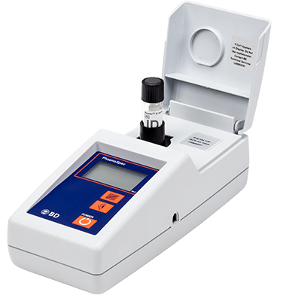



Nephelometer

Slide 9
Nephelometer
The standard
Range of sizes
Based on light scattering
Advantages:
Most accurate
Disadvantages:
$$$

Slide 10
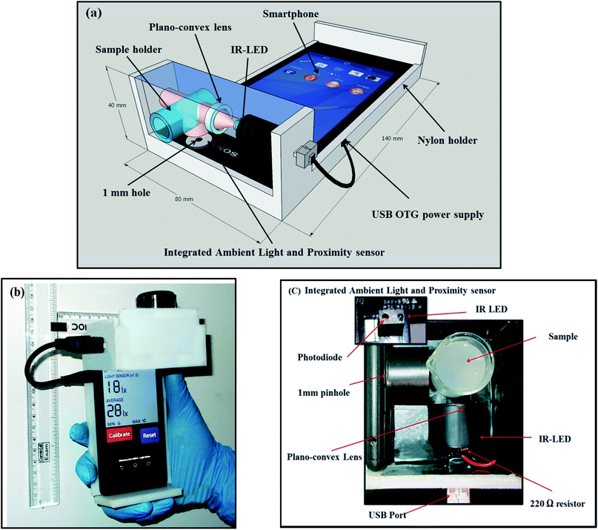
Water turbidity sensing using a smartphone and attached device
Hussain, I., Ahamad, K., & Nath, P. (2016). Water turbidity sensing using a smartphone. Rsc Advances, 6(27), 22374-22382.

Slide 11
Water turbidity sensing using a smartphone and attached device
Application + special device
Uses devices sensors and smartphone computing resources
Based on light scattering
Advantages:
Highly portable
High accuracy
Disadvantages:
Availability
$$

Slide 12
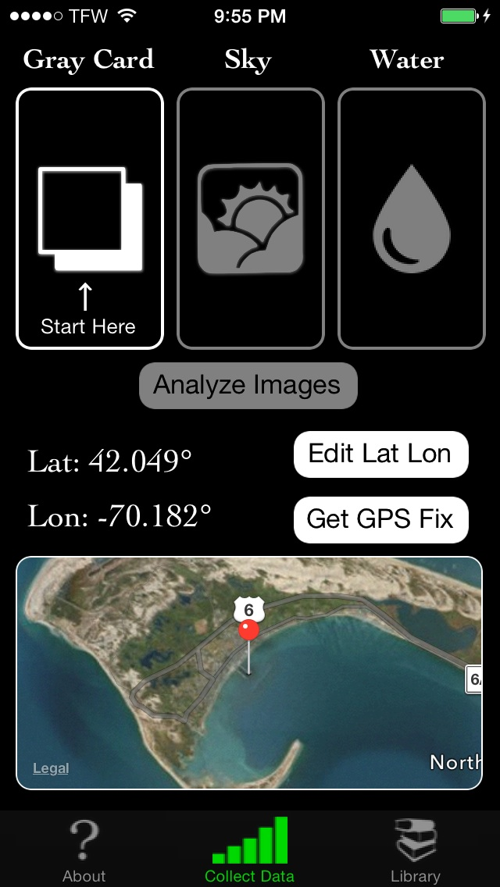
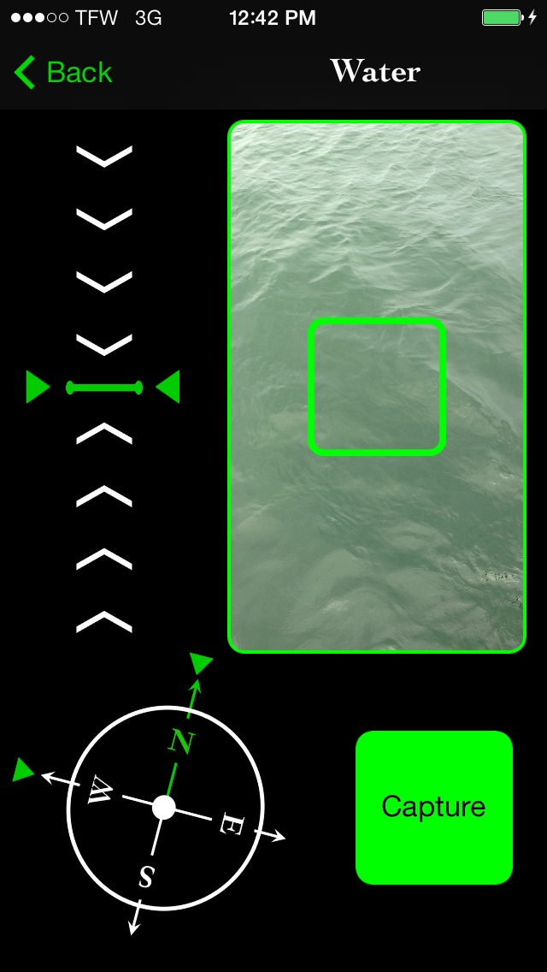
‘HydroColor: Water Quality App’

Slide 13
‘HydroColor: Water Quality App’
Android smartphone application
Uses the smartphone's digital camera
Based on the reflectance of the water
Advantages:
Highly portable
Disadvantages:
Accuracy
$
calibration

Slide 14
Possible Approaches

Slide 15
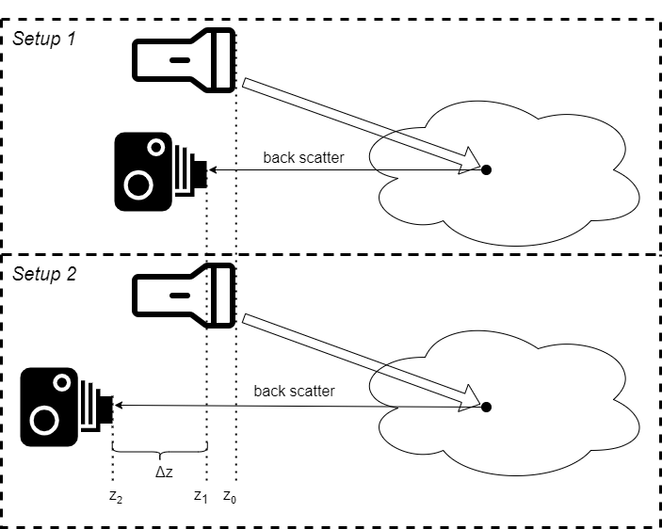

Beam Attenuation
Light source is fixed
Camera moved horizontally
Measuring difference in backscattered light
Main Disadvantage:
Requires external light to be negligible
Requires “clean” scene
$$c^{\left(k\right)}=−\frac{1}{Δz}\ln\left(\frac{{\left(I_{2}\right)}^{\left(k\right)}}{{\left(I_{1}\right)}^{\left(k\right)}}\right)$$

Slide 16
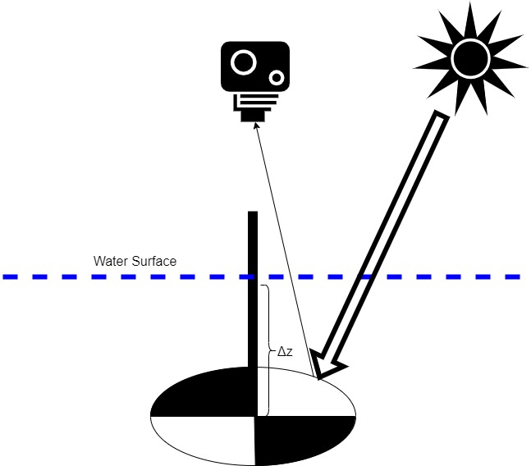

Secchi Disk
Disk is lowered vertically
Measures by disappearance depth
Main disadvantage:
Requires very deep water body
$$Δz=\frac{\ln\left(\frac{C_{0}}{C_{T}}\right)}{c+K}$$

Slide 17
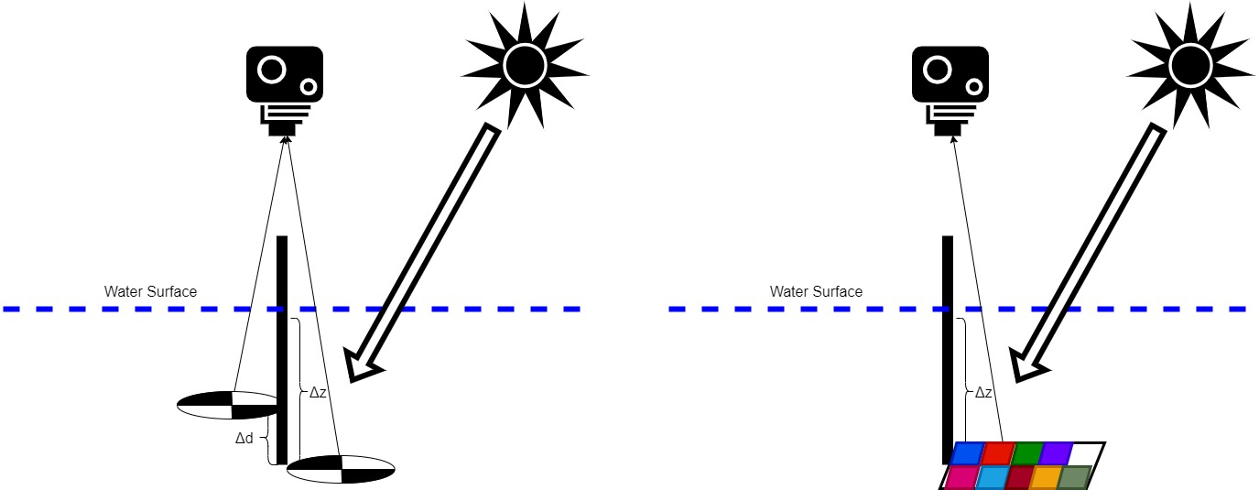
Secchi Disk Improvements
Two targets – reduce required depth
Use color table target – specific wavelength

Slide 18
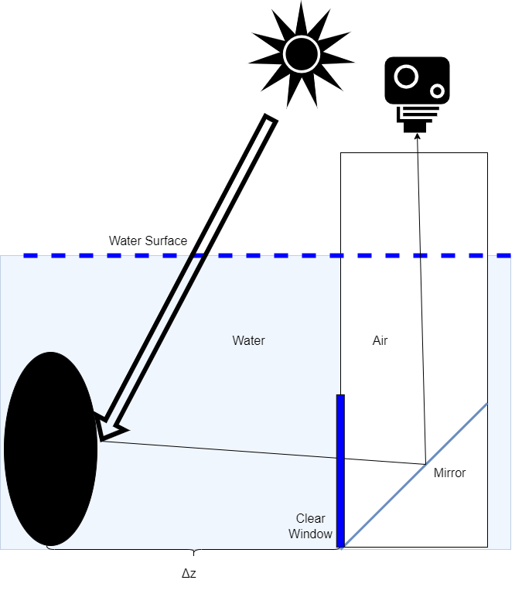

Black Disk
Move the disk horizontally
Based on the disappearance distance
Main disadvantage:
Requires very wide water body
Additional complexity due to viewing apparatus
$$Δz=\frac{\ln\left(−\frac{1}{C_{T}}\right)}{c}$$

Slide 19
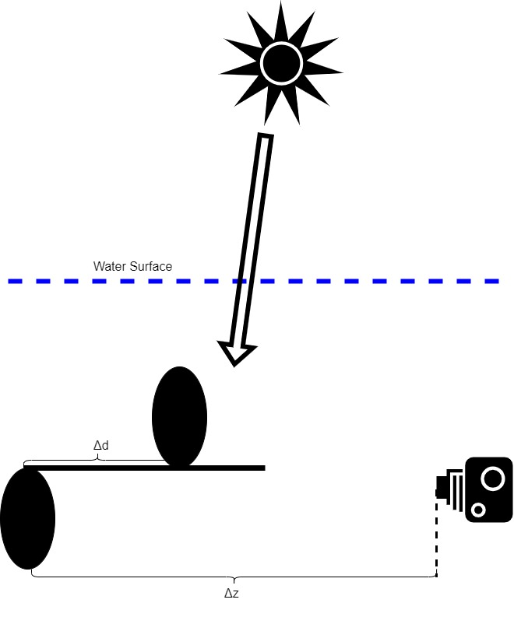
Black Disk Improvements
Take photo underwater – reduce complexity and reflection effect
Two targets – reduce required distance

Slide 20
Purposed Solution

Slide 21
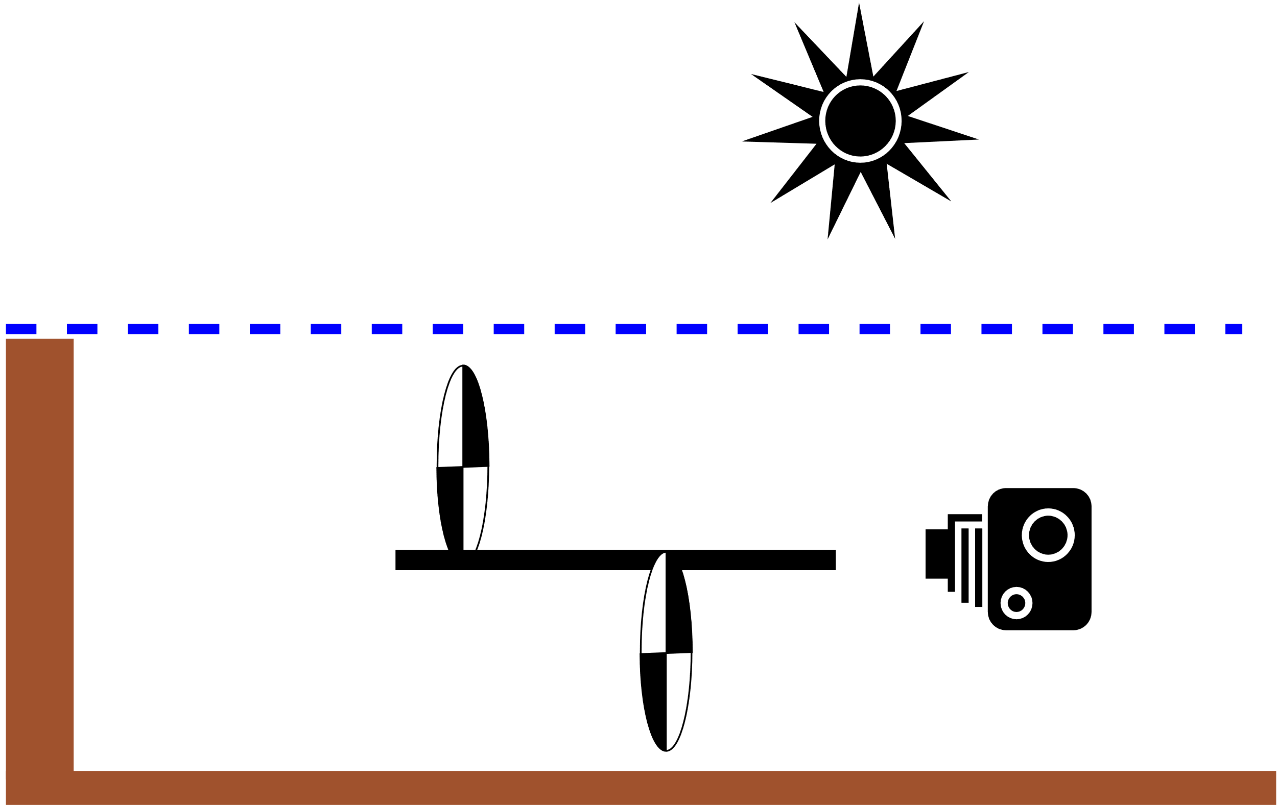
Basic Assumptions
Water body dimension fit to measuring device
Turbidity conditions that fit for optical measurement
Daylight/mobile phone flashlight
Consistency of water turbidity in water body

Slide 22

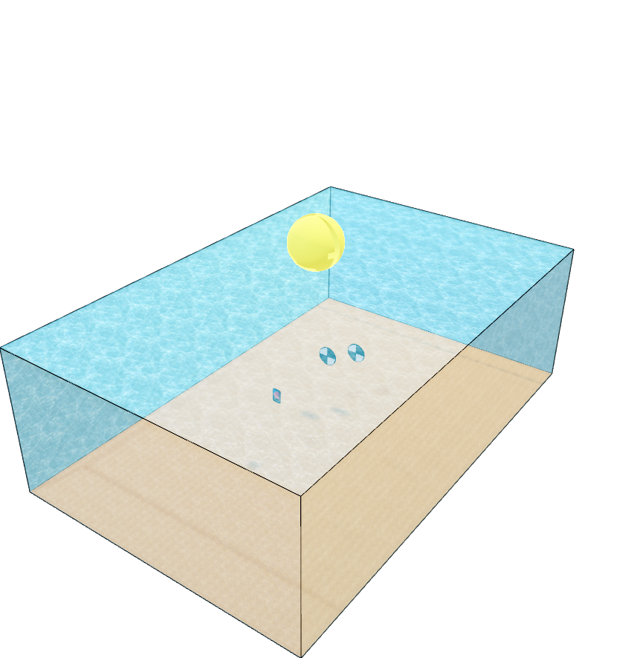
Measurement Setup

Slide 23
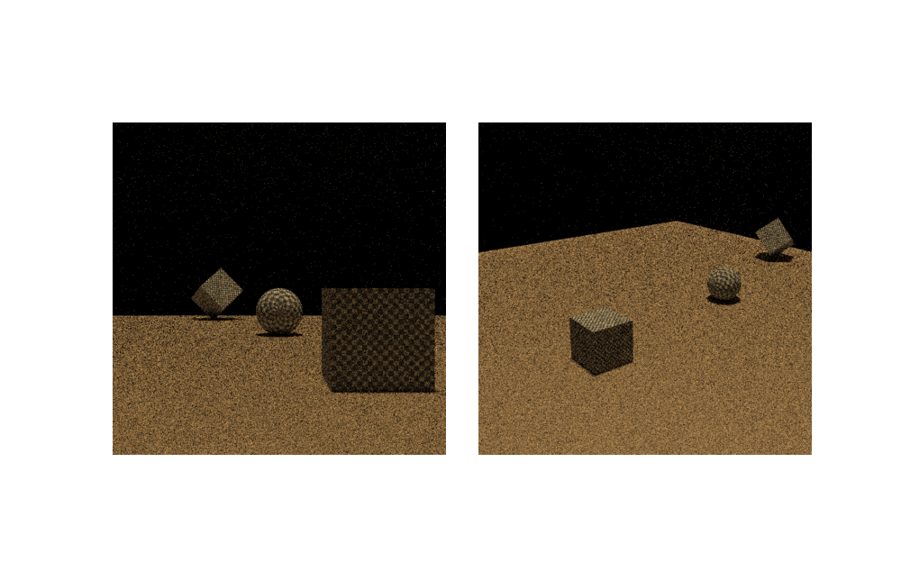
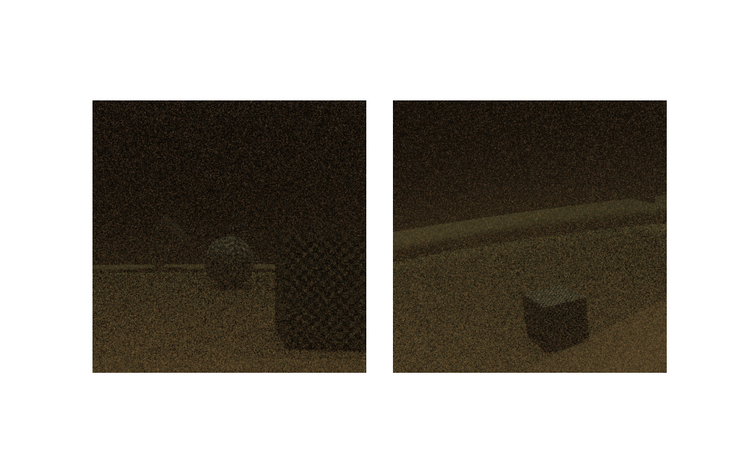
Challenges in Simulating Realistic Scene
Sensor is inside the medium
Sensor is just outside the medium

Slide 24






Simulations
$$σ_{S}=\left(0.2, 0.1, 0.1\right)$$
$$σ_{A}=(0.45, 0.06, 0.05)$$
$$σ_{S}=\left(0.7, 0.7, 0.7\right)$$
$$σ_{A}=(0.45, 0.06, 0.05)$$
$$σ_{S}=\left(0.4, 0.4, 0.4\right)$$
$$σ_{A}=(0.45, 0.06, 0.05)$$

Slide 25
Block Diagram
Mobile Phone
Raw image
Image pre-processing
Turbidity calculation
Logger
Web
Database
World wide measurements
Time, date, GPS location etc.
Other smartphone sensors
Other user’s smartphones/computers
UI

Slide 26
Milestones
so far:
Theoretical study
Chose optimal approach
Simulations
next:
Write and test the program
Mobile app
Targets kit

Slide 27
Timeline
NOV
DEC
JAN
FEB
(EXAMS)
MAR
APR
MAY
Research
Algorithm
Development
APP
Simulations
Measuring Kit
Approach Selecting
Adding Features

